Slide 1
Thermodynamic properties of A pure substance

Slide 2
Thermodynamic Properties
The distinguishing characteristics of a system, basically quantities needed
to specify a Macroscopic Description/State of System completely.
Either directly or indirectly measurable
Change is independent, hence can be written as exact differential.
Pure Substance
Single chemical species having uniform composition throughout, generally can be described by two variables.

Slide 3
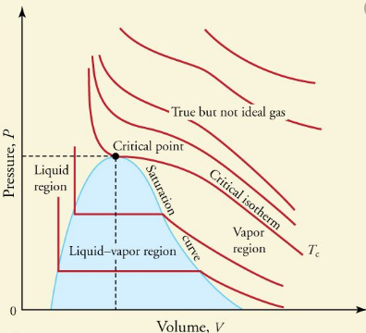
Phase:
A specified mass of a substance having uniform composition and
physical state throughout.

Slide 4
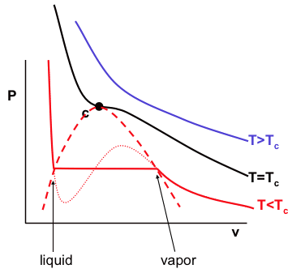

Slide 5
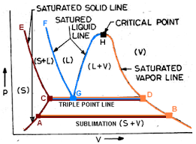

Slide 6
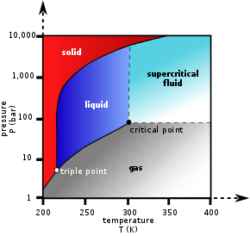

Slide 7
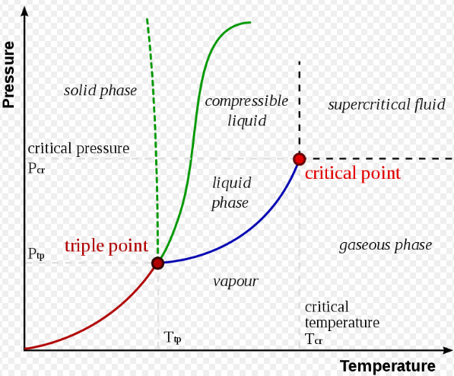
Water

Slide 8
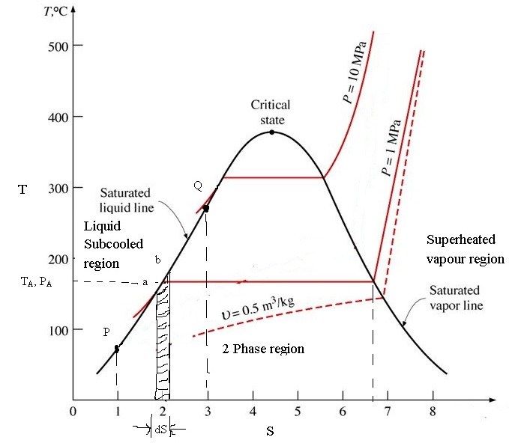

Slide 9
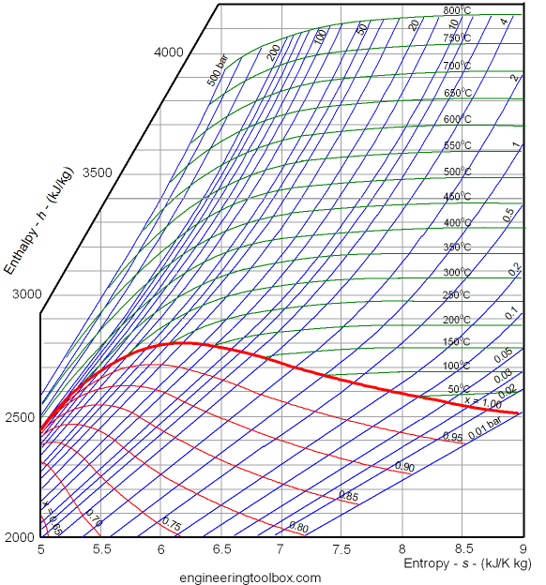

Slide 10
